Slide 1


Final Project FDS
Fabrizio Rossi 1815023
Matteo Orsini 1795119
Mina Makar 1804475

Slide 2
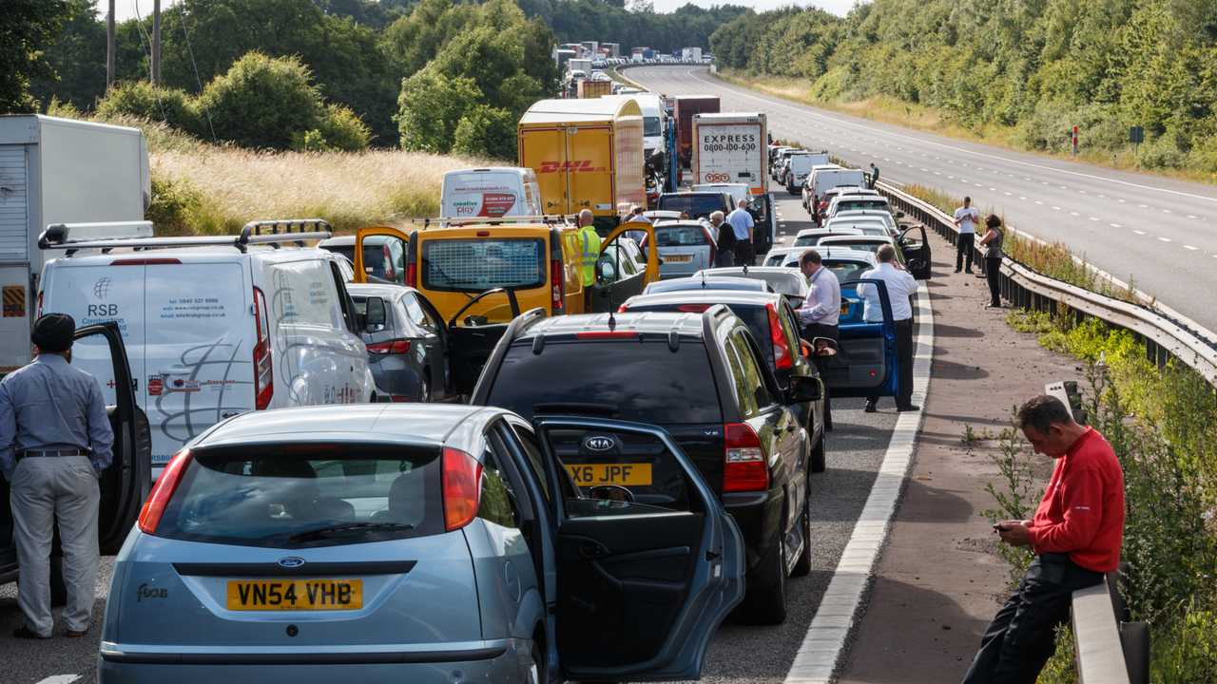
Task and motivation
Classify the effects on the traffic of an accident on a scale {1, 2, 3, 4}
Could be useful to take actions to regulate the traffic when an accident occurs

Slide 3
Models and tools
We would like to:
Implement our solution from scratch
Use pandas library to process the features
Use scikit-learn for the machine learning tools
In particular, we would like to test the following models:
Logistic regression
Naive Bayes
SVM
Neural Networks

Slide 4
Analysis
We are going to use a Kaggle dataset about US accidents with about 3.5 million records and 50 features (road features, weather infos, GPS position, time) to fit the models https://www.kaggle.com/sobhanmoosavi/us-accidents
We are going to compute the following metrics:
  Accuracy
  Precision
  Recall
  F1-score
  PR Curve

